Slide 1
Applet in java

Slide 2
Java Applet
An applet is a Java program that runs inside the web browser and works at client side. An applet is embedded in an HTML page using the APPLET or OBJECT tag and hosted on a web server.
Applets are used to make the website more dynamic and entertaining.
Execution of an applet does not begin at main() method.
Types of Applet:
  Applet
  JApplet

Slide 3
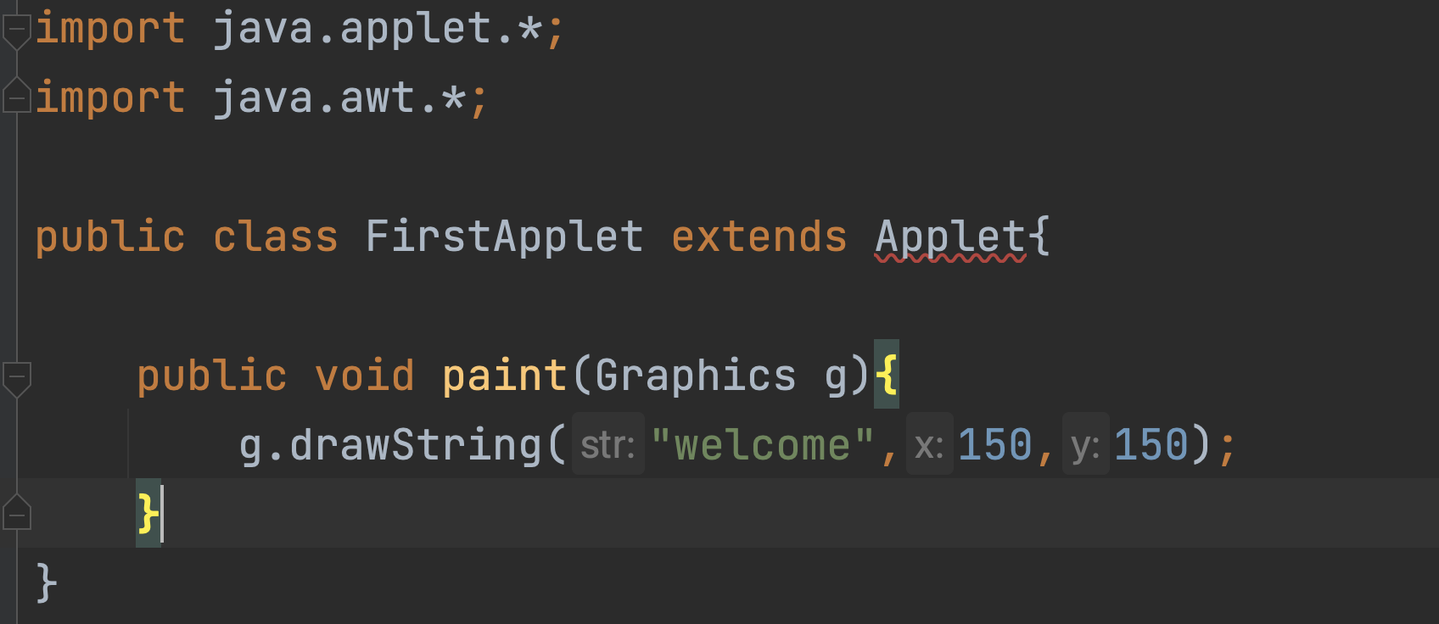

Slide 4
Running with Html
<html>
<body>
<applet code="FirstApplet.class" width="300" height="300">
</applet>
</body>
</html>

Slide 5
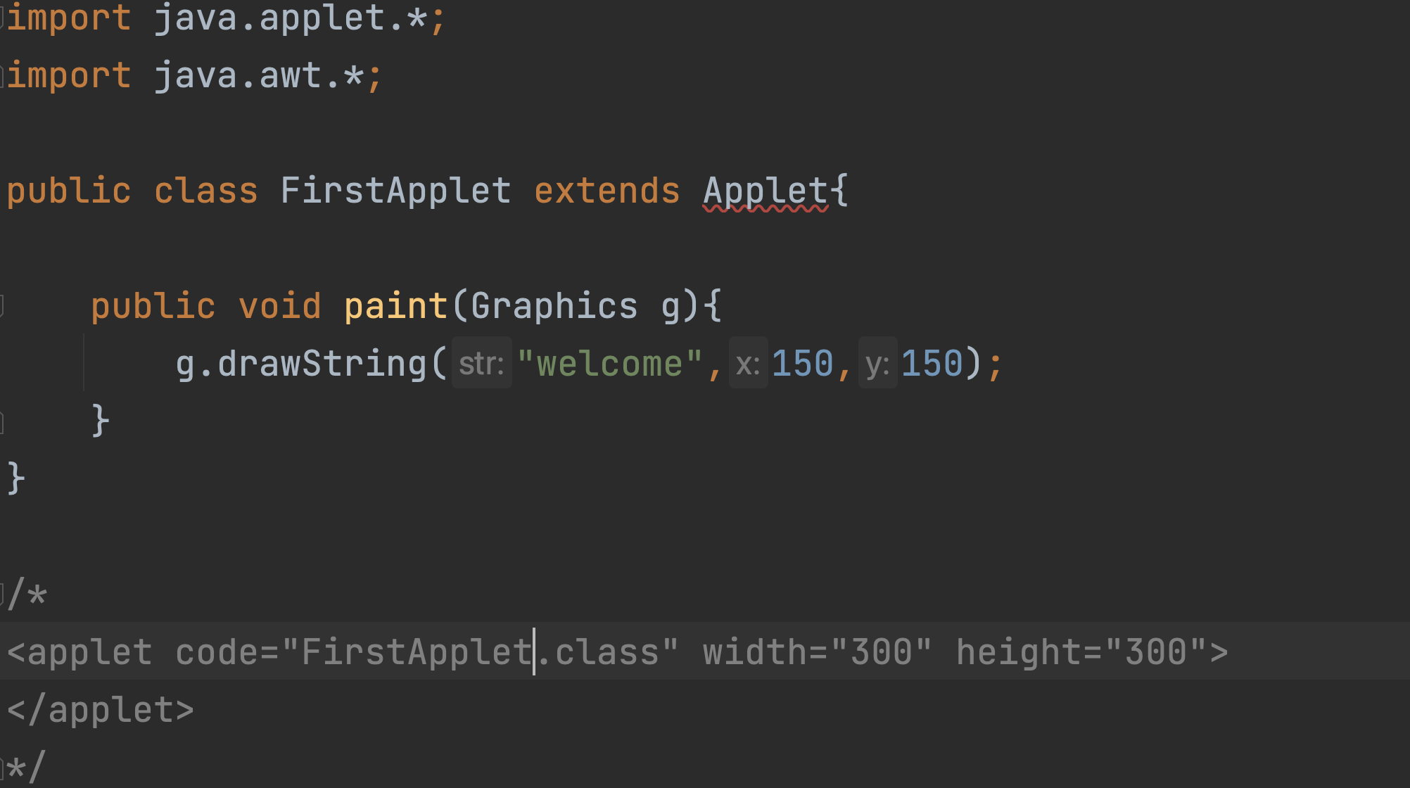
Running with applet viewer

Slide 6
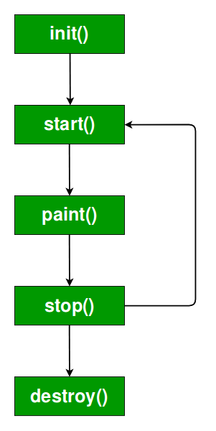
Applet Life cycle

Slide 7
init
  This method is intended for whatever initialization is needed for your applet.
  It is called only once in a program
start
  This method is automatically called after the browser calls the init method.
  It is also called whenever the user returns to the page containing the applet after having gone off to other pages.
paint
  Invoked immediately after the start() method, and also any time the applet needs to repaint itself in the browser.
  The paint() method is actually inherited from the java.awt.
stop
  This method is automatically called when the user moves off the page on which the applet sits.
  It can, therefore, be called repeatedly in the same applet.
destroy
  This method is only called when the browser shuts down.

Slide 8
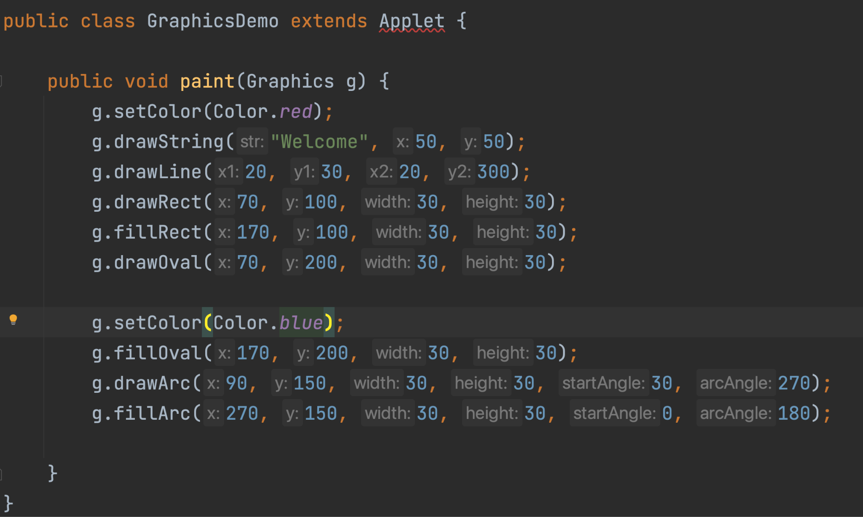

Slide 9
Taking parameter in applet
import java.applet.Applet;
import java.awt.Graphics;
public class UseParam extends Applet{
public void paint(Graphics g){
String str=getParameter("msg");
g.drawString(str,50, 50);
}
}

Slide 10
<html>
<body>
<applet code="UseParam.class" width="300" height="300">
<param name="msg" value="Welcome to applet">
</applet>
</body>
</html>

